Slide 1

B.Tech Thesis Presentation
‘Crashworthiness optimization of NPR structure with Artificial Intelligence’
’
Presented by:
Mainak Mallick (Enroll No-511318017)
Tarun Kurakula (Enroll No-511318018)
Dipayan Parbat (Enroll No- 511318019)
Under the guidance of :
Dr. Niloy Khutia
Associate Professor
Department of Aerospace Engineering and Applied Mechanics
Indian Institute of Engineering Science and Technology, Shibpur
May 18, 2022

Slide 2
Content
Introduction & Literature Review
Brief on Auxetic(NPR) Structure
Properties of GFRP Composite
Problem Statement and Simulation
Implimentation of Artificial Neural Network
Optimization with MOPSO
Results and Discussions
Conclusion

Slide 3
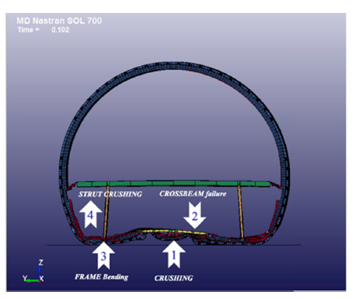
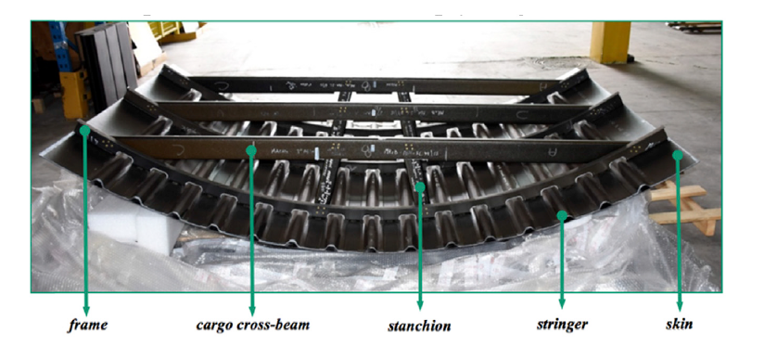
Literature Review
Crashworthiness is the ability of an aircraft structure and its internal systems to protect occupants from injury in an event of crash.
During a crash landing, the kinetic energy should be dissipated in a controlled way by the crushing of the structure below the passenger floor.
Energy is dissipated by stanchions connecting the frames and beams on the cargo floor, below the subfloor beams.
(Guida et al,[1])
Here comes the need to develop various novel structures
Absorb high impact energy
Very less weight
Peak reaction force is in limit

Slide 4
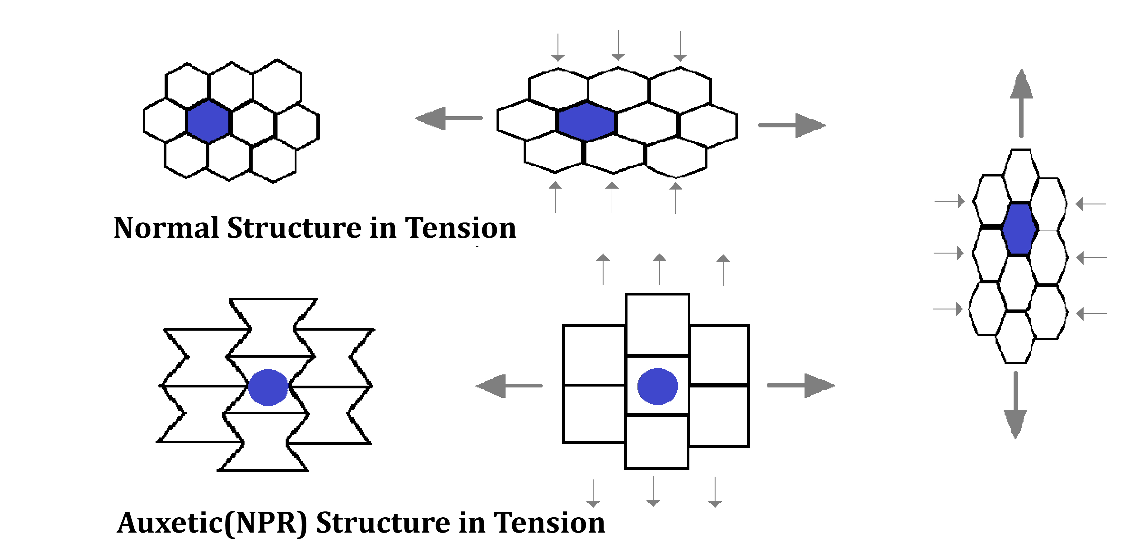
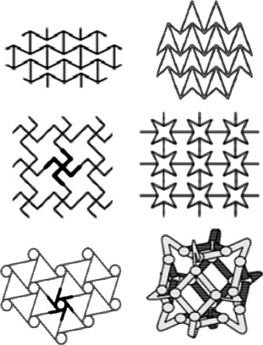
Auxetic Structures
Materials with a negative Poisson’s ratio, exhibit unusual and counterintuitive mechanical behavior. When stretched, they become thicker perpendicular to the applied force.
New research indicates to have mechanical properties such as high energy absorption and fracture resistance.
3D NPR structures is a bit less explored due to its manufacturing difficulty.
Some other examples
(Yunan et al,[1])

Slide 5
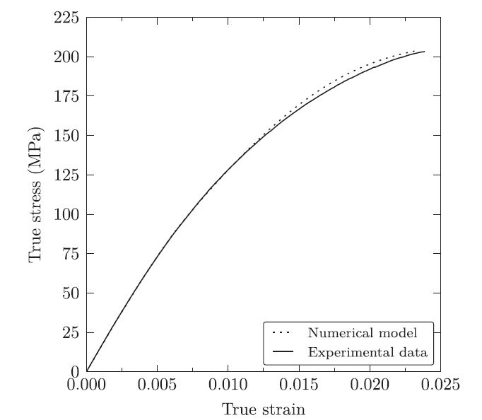
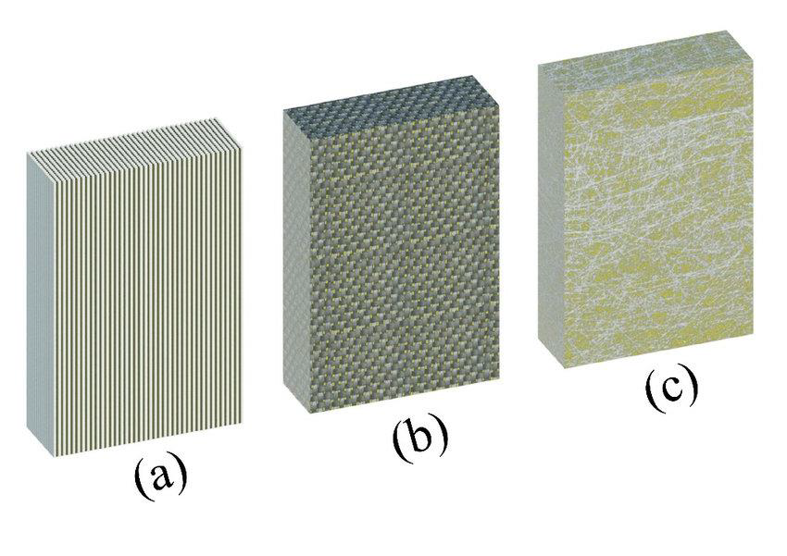
Properties of GFRP
Glass-Fibre Reinforced Plastic or GFRP. It is a composite material that consists of a polymer matrix and glass fibres.
Advantages:
Can resists both compressive and tensile forces very well
Isotropic in nature so it is a commonly utilized filament
Well resistant to water and chemicals
Low cost
(Diaz et al,[3])
Disadvantages:
Comparatively low elastic modulus
Low resistant to alkaline
Low long-term strength due to stress rupture.
(Diaz et al,[3])

Slide 6
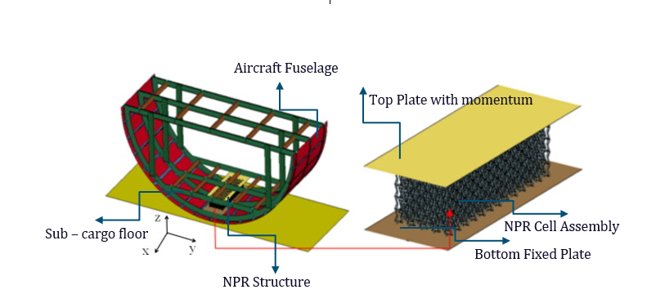
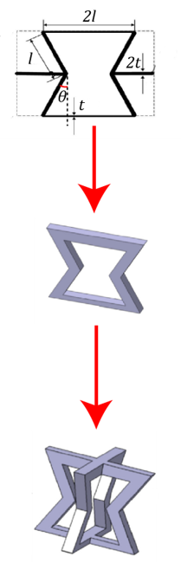

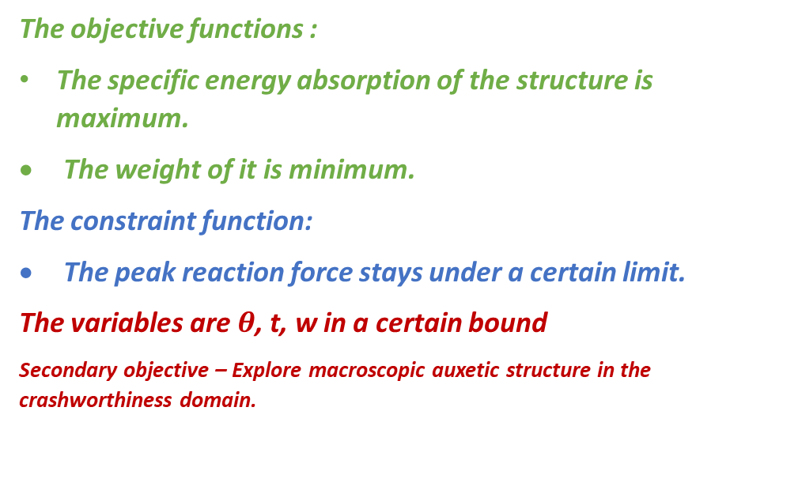
Problem Statement
The objective functions :
The specific energy absorption of the structure is maximum.
The weight of it is minimum.
The constraint function:
The peak reaction force stays under a certain limit.
The variables are $θ$, t, w in a certain bound
Secondary objective – Explore macroscopic auxetic structure in the crashworthiness domain.
Replicate the energy absorbing NPR structure from reference research work and validate the FE model.
Train a Neural Network from the obtained data to predict other combinations.
Get the optimized results via Particle swarm algorithm
Calculate SEA, Mass and Peak Reaction Force for each combination in ABAQUS CAE for different sample combination.
w
t
$$θ$$
(Wang et al.[4])

Slide 7
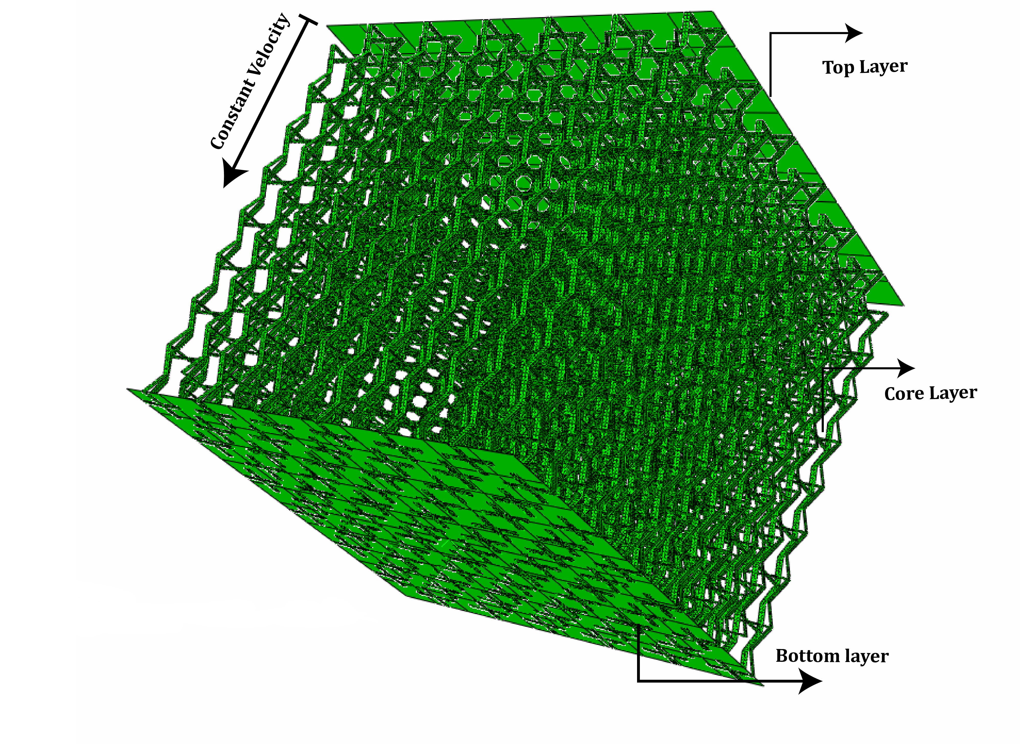
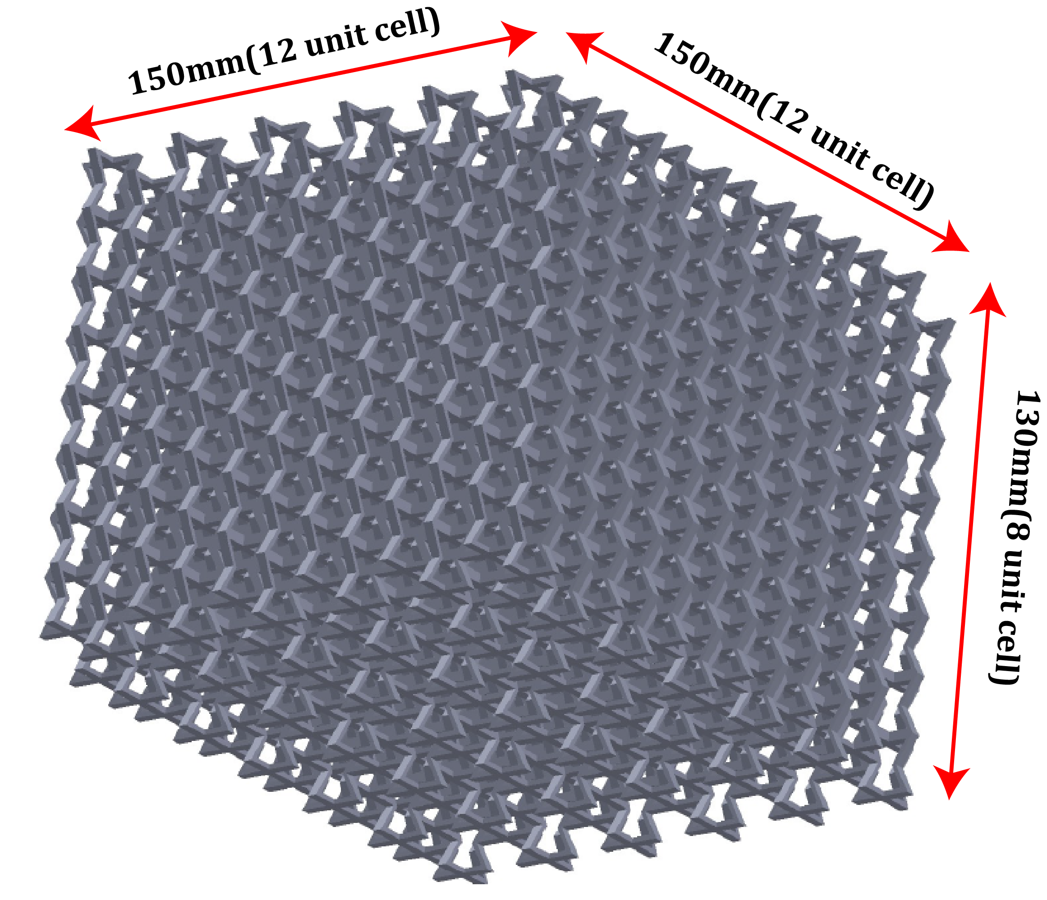
Finite Element Modelling
Single cells were done through Python Scripting for automation.
Manually replicated to create the assembly
GFRP elasto-plastic properties were implemented.
Mesh is created using S4R quad shell elements with a size of 0.2mm with 6DOF per node.
Total number of elements for single cell is 5677.
h
Initial variables | Values
Length(l) | 10mm
Thickness(t) | 3mm
Angle(theta) | 30 deg

Slide 8
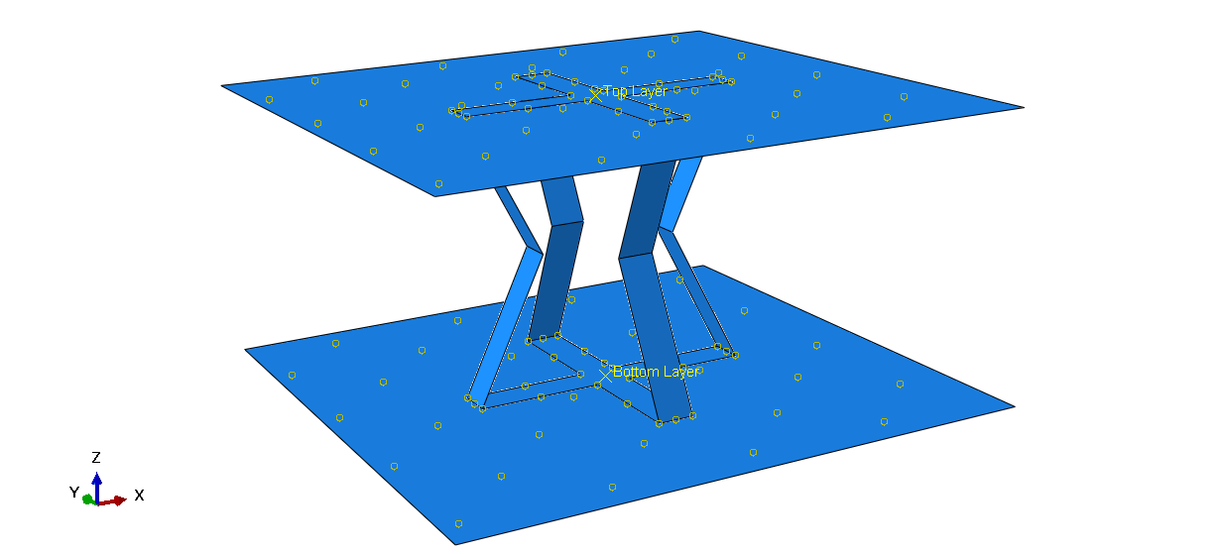

Boundary Conditions
Simulation was done on each cell.
Crushing step 0.001 sec.
Friction coefficient of 0.2 in between all surfaces.
Tie constraint was given to the upper and lower plate with the unit cell.
The lower plate was encastred.
Velocity given to the upper plate is 11.6m/s .
The inertial mass given to the top layer is .275tonne.
V3=11.6m/s
U1=U2=U3=UR1=UR2=UR3=0

Slide 9
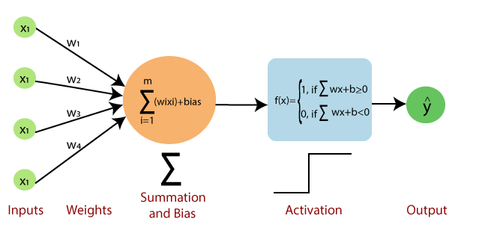
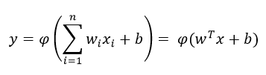
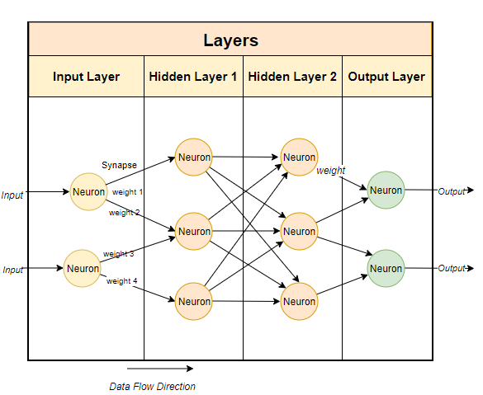
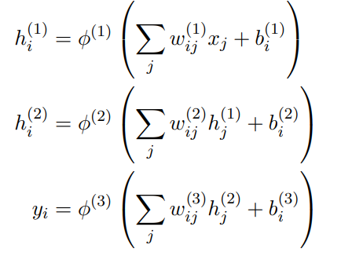
Neural Network and prediction
Single layer perceptron model
Multi-layer perceptron model

Slide 10
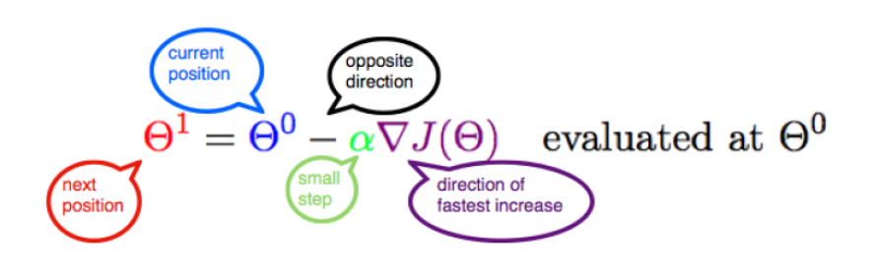
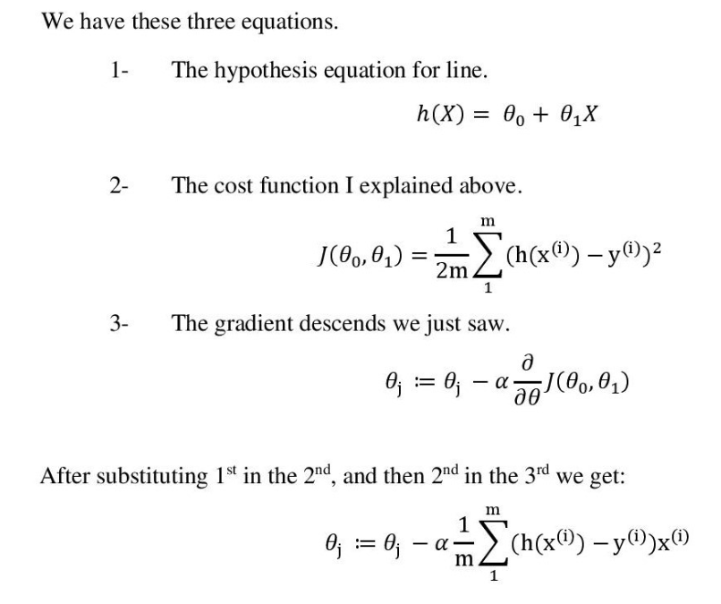
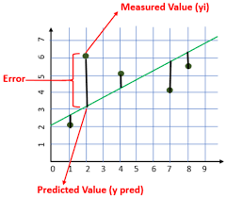
Neural Network continued
Primary Statistical gradient descent (GD)
Optimization of neural network is required to get accurate predictions and quantify the error in it and often done by calculating a loss function and calibrating the weights and biases along with it.
Gradient Descent

Slide 11
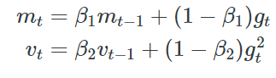
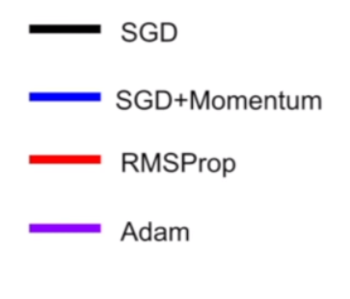
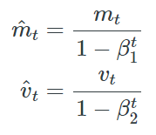

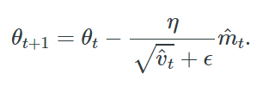
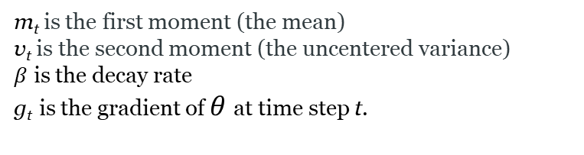
Neural Network continued
Adaptive Moment Estimation(ADAM) in brief
m_{t} is the first moment (the mean)
v_{t} is the second moment (the uncentered variance)
$β$ is the decay rate
g_{t} is the gradient of $θ$at time step t.
Optimization Methods for Neural net
m_{t} and v_{t} are computed first for next step
Biases are counteracted by computing bias-corrected first and second moment estimates
Updating the new parameters

Slide 12
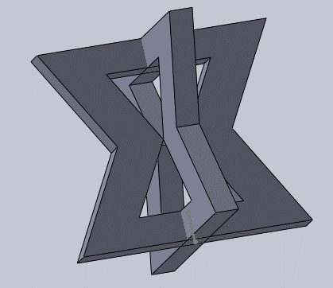
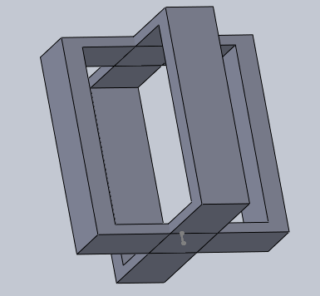
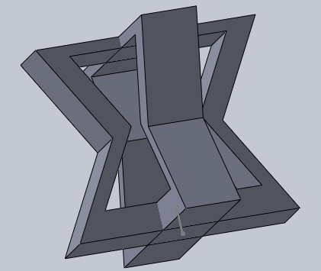
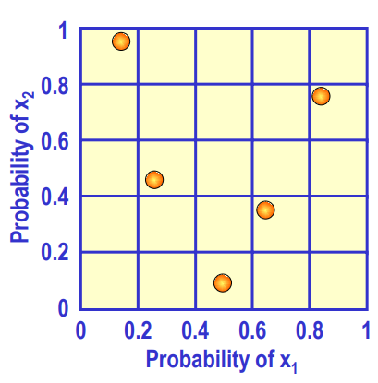
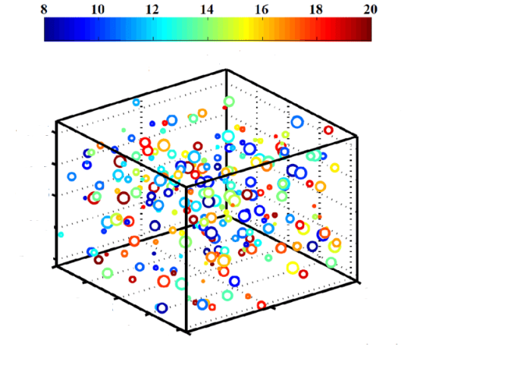
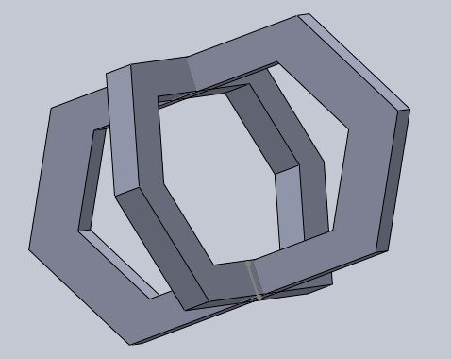
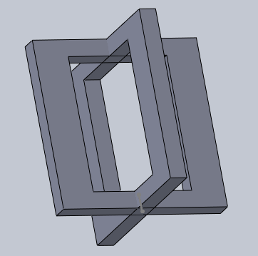
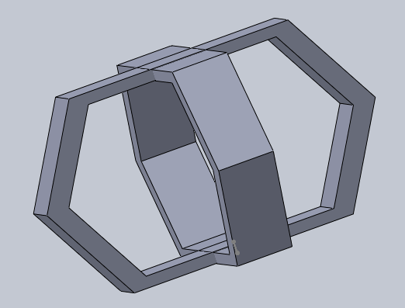
Neural Network and LHS
Latin hypercube sampling (LHS) – A statistical method for generating a near-random sample of parameter values from a multidimensional distribution.
Information of the used Neural net
Deep learning package used – TensorFlow, Keras.
Number of sample combinations generated through LHS for training- 200
Specs of learning model used – 1 input node, 1 output node and 2 hidden layer with 64 node in each layer.
Total epochs – 1200
Some sample variations fig provided below
A Latin square - If (and only if) there is only one sample in each row and each column.
A Latin hypercube - Generalization of this concept to an arbitrary number of dimensions.

Slide 13
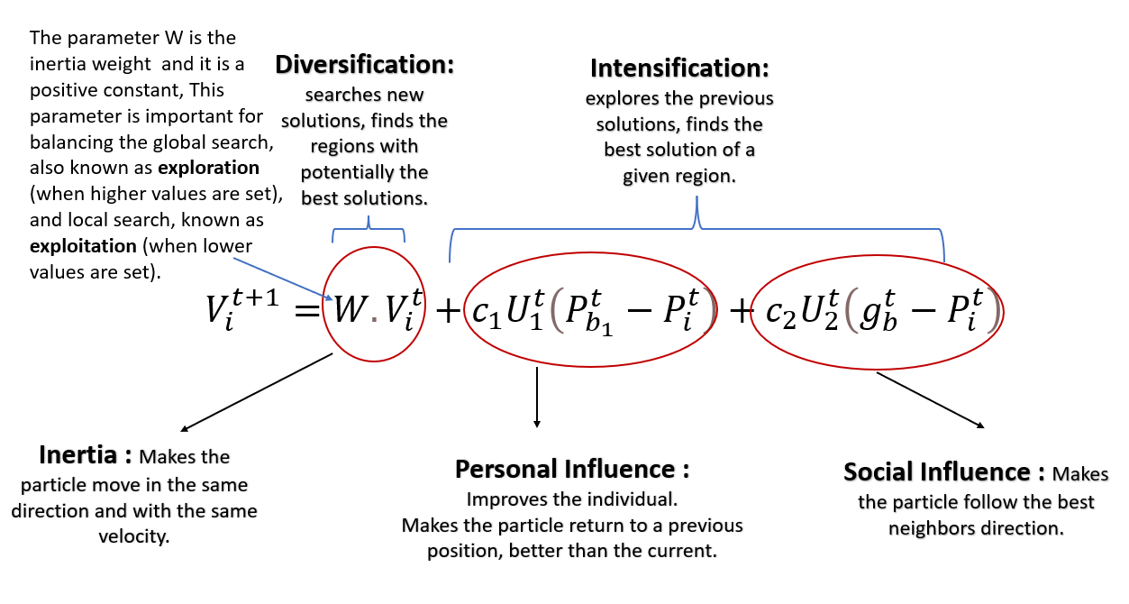
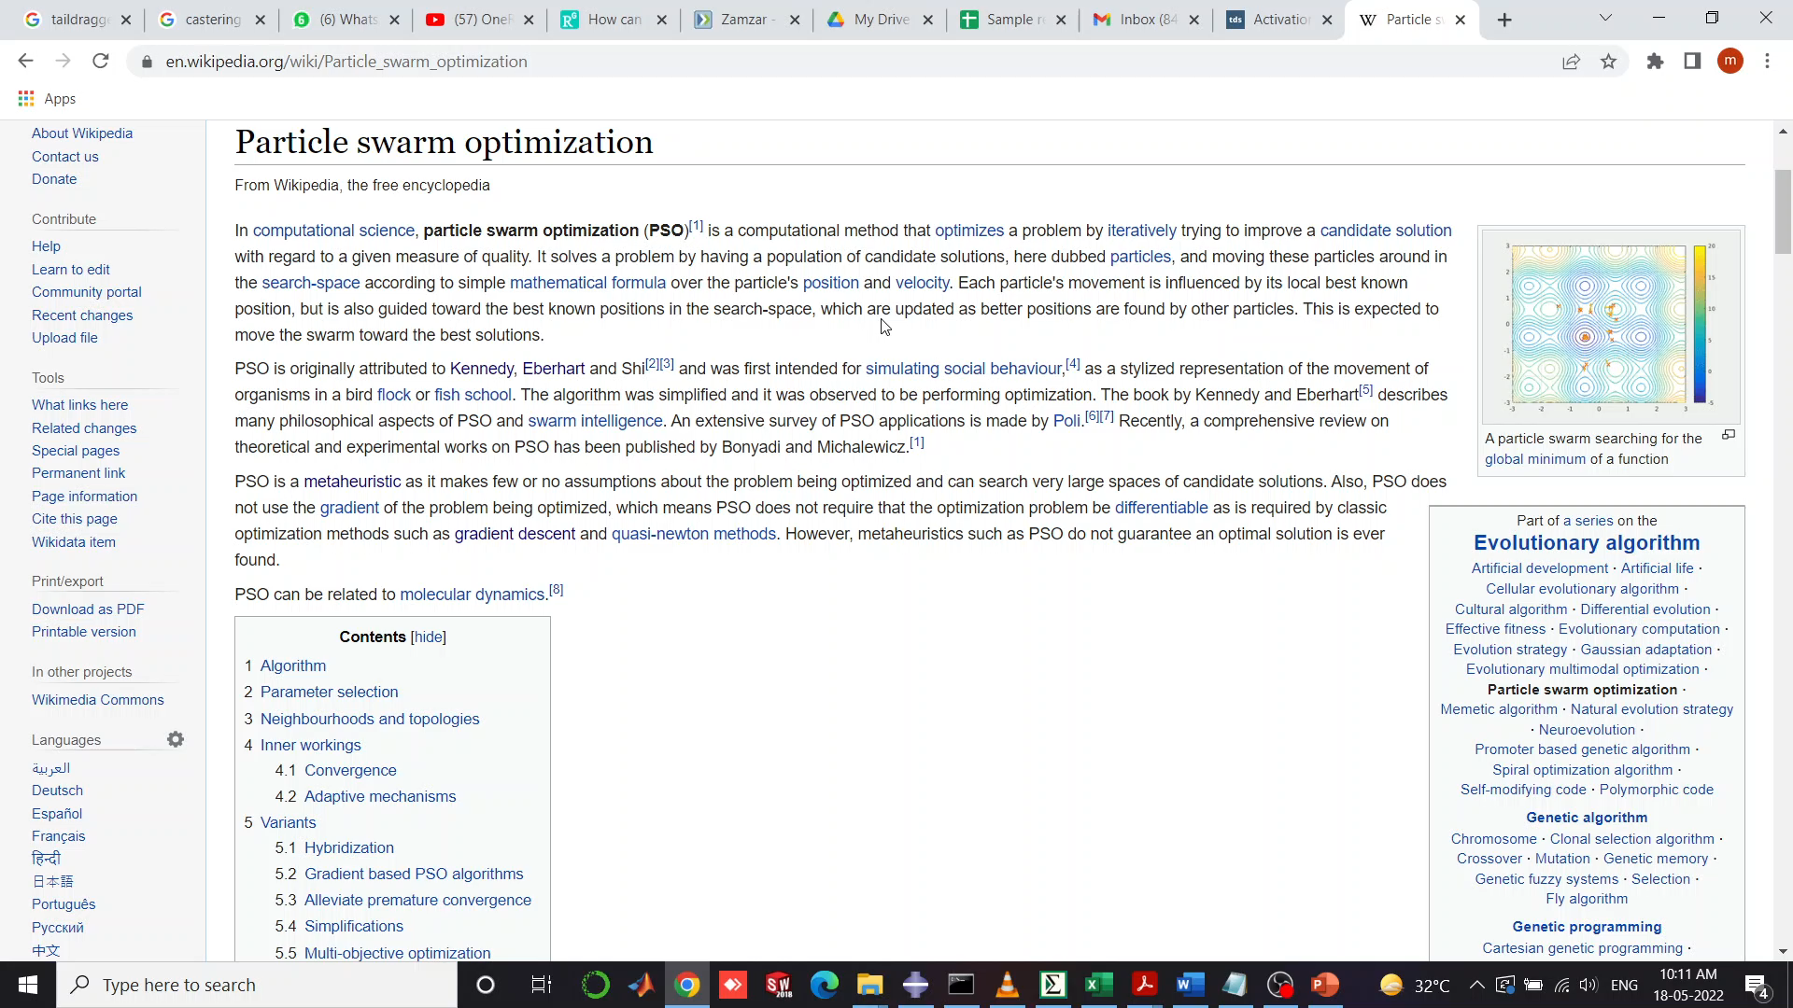
Particle Swarm Algorithm(PSO)
Take P particles(a matrix) and position of i_{th} particle as
If at t_{th} time step,
Velocity V^{i}_{t} = (v_{x}^{i}_{t},v_{y}^{i}_{t})
Position X^{i}_{t} = (x^{i}_{t},y^{i}_{t})
Then at t+1_{th} time step,
Velocity V^{i}_{t+1} = wV^{i}_{t}+ c₁r₁(pbest-X^{i}_{t}) + c₂r₂(gbest-X^{i}_{t})
Position X^{i}_{t+1} = X^{i}_{t} + V^{i}_{t+1}
PSO is a stochastic optimization technique based on the movement and intelligence of swarms.
Developed by Kennedy, Eberhart in 1995.
Diversification
Where,
U₁ and U₂ are random numbers between 0 and 1
c₁ and c₂ are called the cognitive and the social coefficients respectively
W is the inertia weight
Individual best result for a particle is known as personal
best or pbest.
The best value of any particle is the global best or gbest.
Social Influence
Best Result
Personal Influence
Searched Sample Space

Slide 14
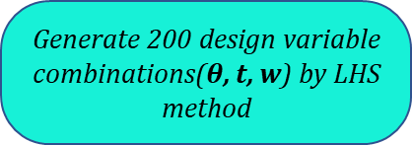
Total workflow of the project
Generate 200 design variable combinations($θ$, t, w) by LHS method
Create a polynomial using RSM and feed it into PSO directly.
Calculate SEA, Mass and Peak Reaction Force for each combination in ABAQUS CAE.
No I/O needed, a polynomial is added inside MOPSO
Integrate it with MOPSO
Generate Pareto optimal front and optimized design variable combinations.
Store the post processed data in a csv file and feed it into a neural network.
Train the Neural Network
Establish the I/O interface between
MATLAB code and Python
Generate a binary file of the trained model which gives out the predicted SEA, Mass and Peak RF if the design variables are provided.
Generate a binary file of the trained model which gives out the predicted SEA, Mass and Peak RF if the design variables are provided.

Slide 15
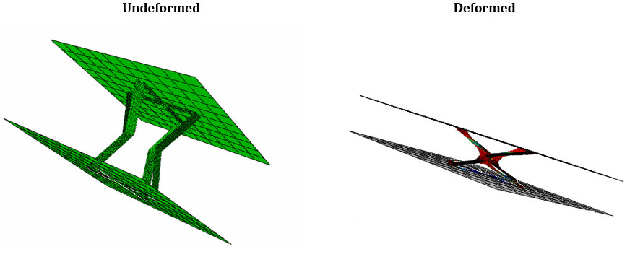
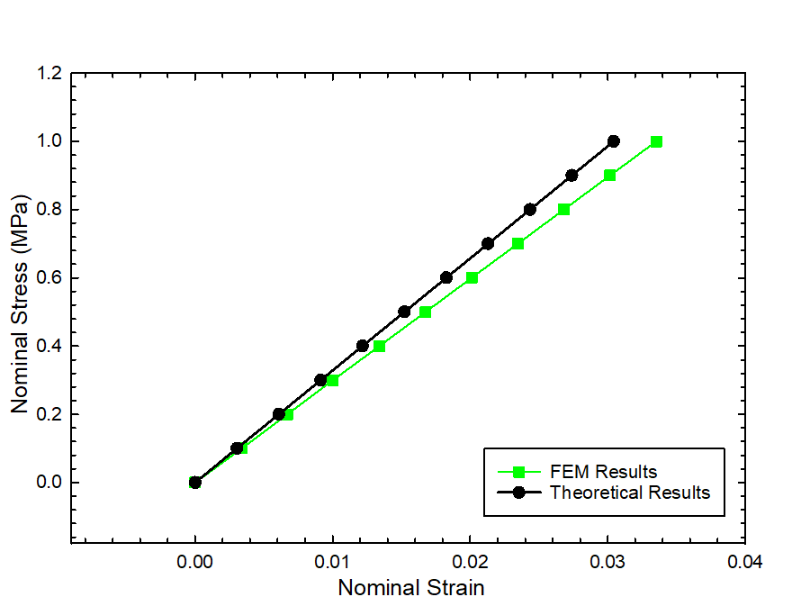
FE Model Validation
To validate the FE Model of single cell, the equivalent elastic modulus is verified with its theoretical counterparts.
Then the elastic modulus is validated for a 4X4 cell assembly
 | Test Results[2] | Analytical results[2] | FEM results
Equivalent elastic modulus | 34.95 | 32.85 | 29.83
Error | - | 6% | 9.19%
[For Nylon material]

Slide 16
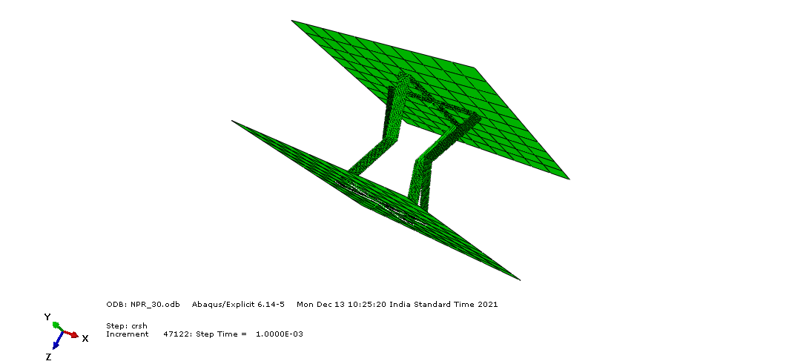
Simulation Results
Changing the Material to GFRP we have extracted our required Energy absorption of the total model
And Reaction force from the other side.
NPR cell
An important thing to note – For 30deg NPR cell the energy absorption is decreased in the later part due to inner
Walls touching with each other.

Slide 17
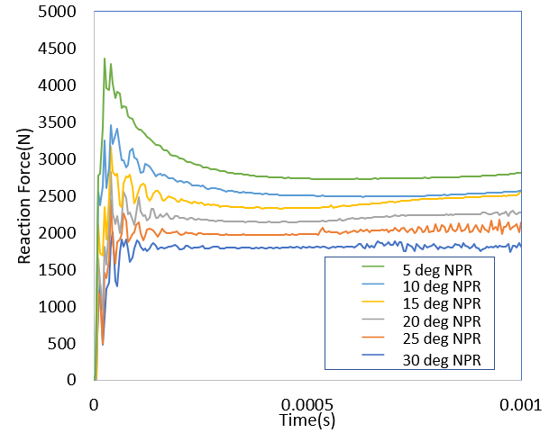
Simulation Results
Reaction Force results for different combinations are given below.
NPR cell

Slide 18
Simulation Results
Some results of sample simulations -
Sl. No | Angle (deg) | Width(mm) | Thickness(mm) | Mass(kg) | Energy(J) | Rf(N)
1 | -24.0472 | 4.372838 | 4.255684 | 0.00403 | 7.89 | 11794.3
2 | -26.1284 | 4.580203 | 2.697816 | 0.00268 | 1.621 | 2877.45
3 | -13.908 | 4.850663 | 2.526085 | 0.00257 | 1.768 | 5372.74
4 | -29.1368 | 3.72006 | 2.302312 | 0.00191 | 0.835 | 2415.57
5 | -27.3489 | 3.039169 | 2.406886 | 0.00163 | 0.821 | 1995.44
6 | 29.37046 | 3.585936 | 4.743985 | 0.00379 | 8.772 | 12420.8
7 | 27.07856 | 4.748824 | 2.882886 | 0.00298 | 2.608 | 5432.66
8 | 18.17504 | 4.280136 | 4.02353 | 0.00368 | 7.958 | 12365.1
9 | 1.772228 | 4.340276 | 2.477442 | 0.00223 | 1.927 | 8033.82
10 | 7.142554 | 3.16829 | 4.123198 | 0.00277 | 9.527 | 11408.5
11 | 11.07861 | 4.080396 | 3.622133 | 0.00312 | 5.827 | 9386.94
12 | -12.062 | 4.449875 | 3.720693 | 0.00348 | 6.88 | 11074.2
13 | 6.087464 | 2.970135 | 2.189879 | 0.00138 | 0.906 | 3598.01
14 | 15.58294 | 2.153994 | 4.9996 | 0.00235 | 9.575 | 10685.3
15 | -19.1257 | 3.222894 | 4.510578 | 0.00316 | 9.003 | 11272.5
16 | -7.59724 | 2.755561 | 3.330106 | 0.00196 | 3.151 | 5549.06
17 | 3.184507 | 2.530012 | 3.969415 | 0.00215 | 7.504 | 8729.69
18 | -3.1729 | 2.460638 | 2.964826 | 0.00156 | 2.034 | 5111.48
19 | -10.9613 | 4.801529 | 2.589658 | 0.00259 | 1.97 | 6004.86

Slide 19
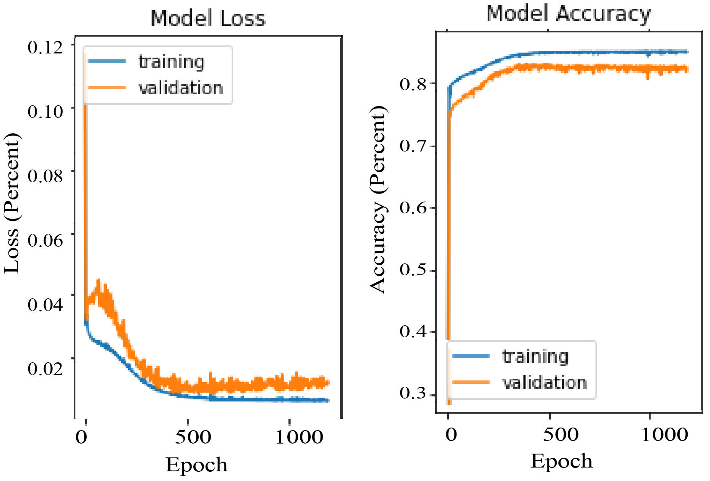
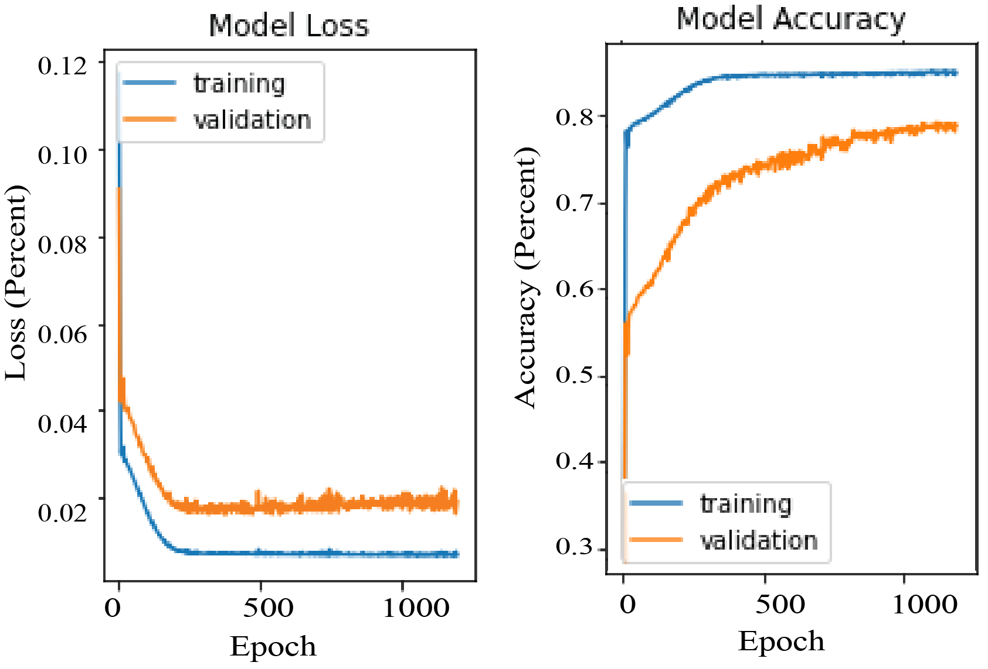
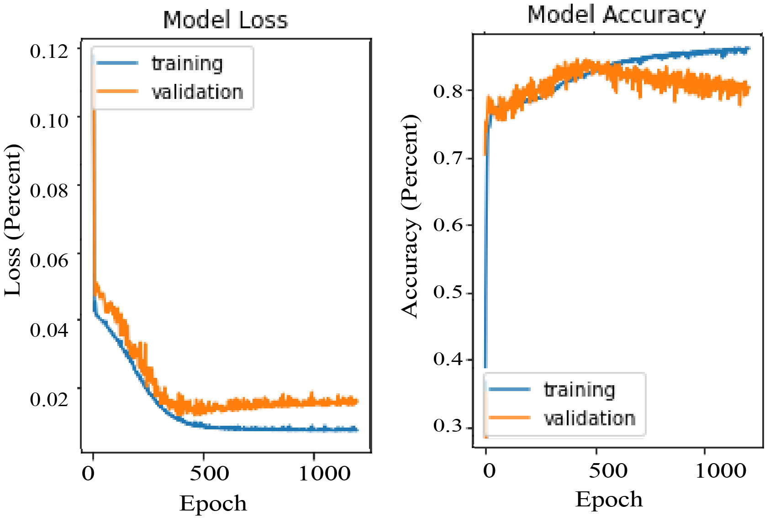
Results And Discussion
Accuracy and loss plot of the training for Mass-
Accuracy and loss plot of the training for RF force-
Accuracy and loss plot of the training for SEA-

Slide 20
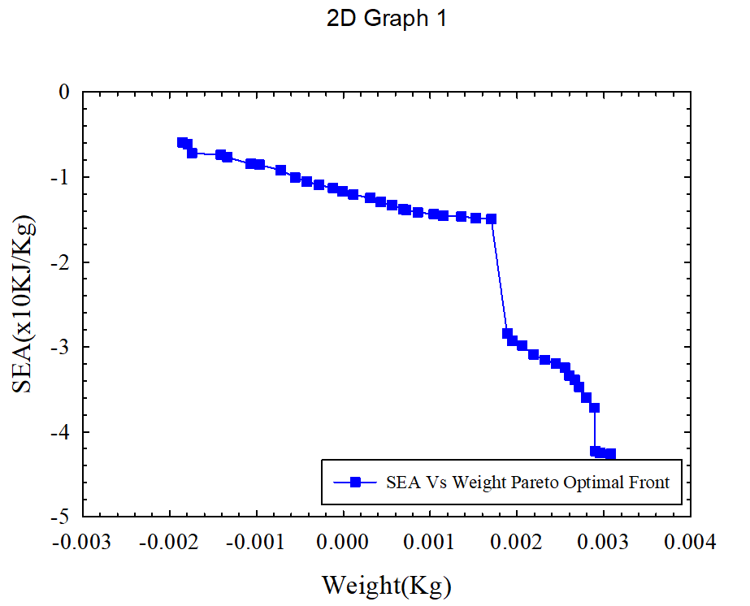
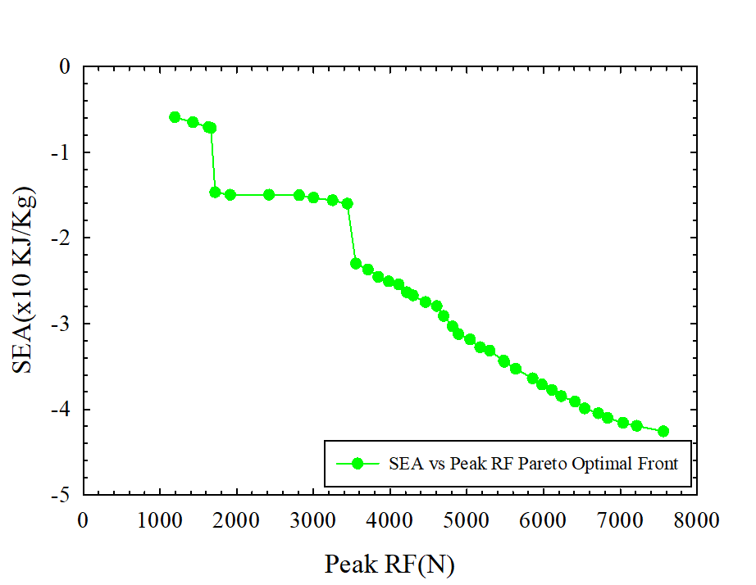
Results And Discussion continued
Sample optimum combinations -
24.80440505 | 2 | 4.489181889
-2.062736724 | 2.996979205 | 4.691235993
30 | 2.905417776 | 2
30 | 2 | 2.29346527
30 | 2.009361494 | 2.085916817
30 | 2 | 2.269011147
Obtained optimum combination - -10 deg., 3.14 mm, 2 mm

Slide 21
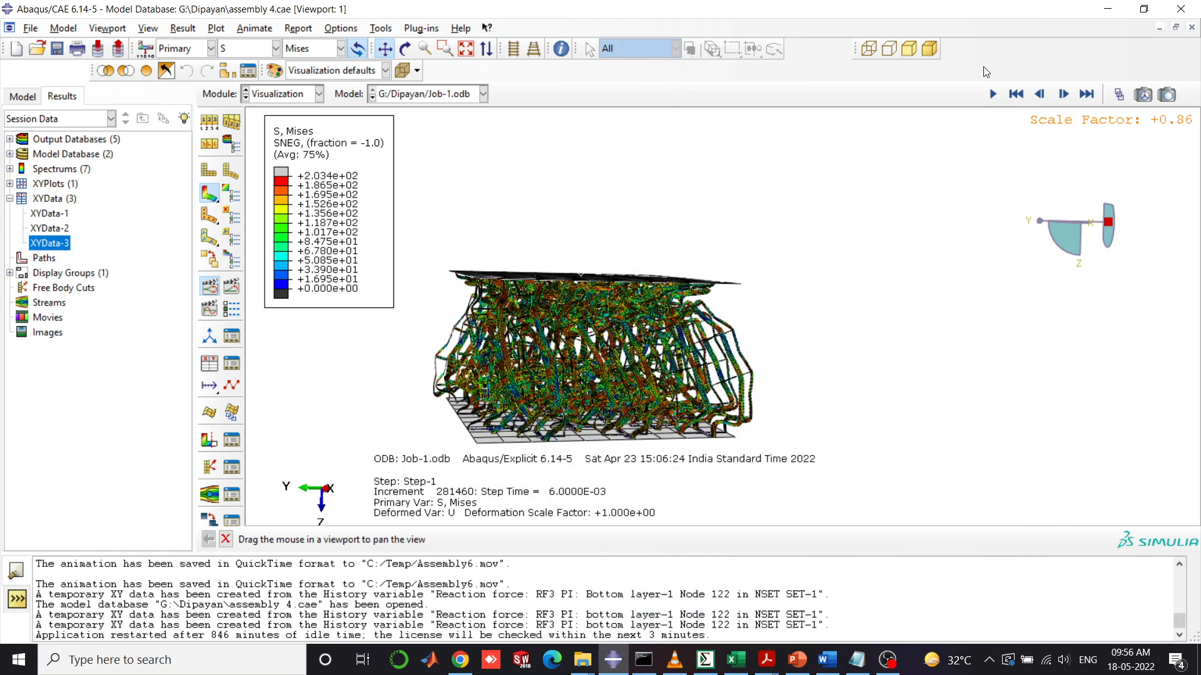
Results And Discussion continued
Animation for demonstration purpose -

Slide 22
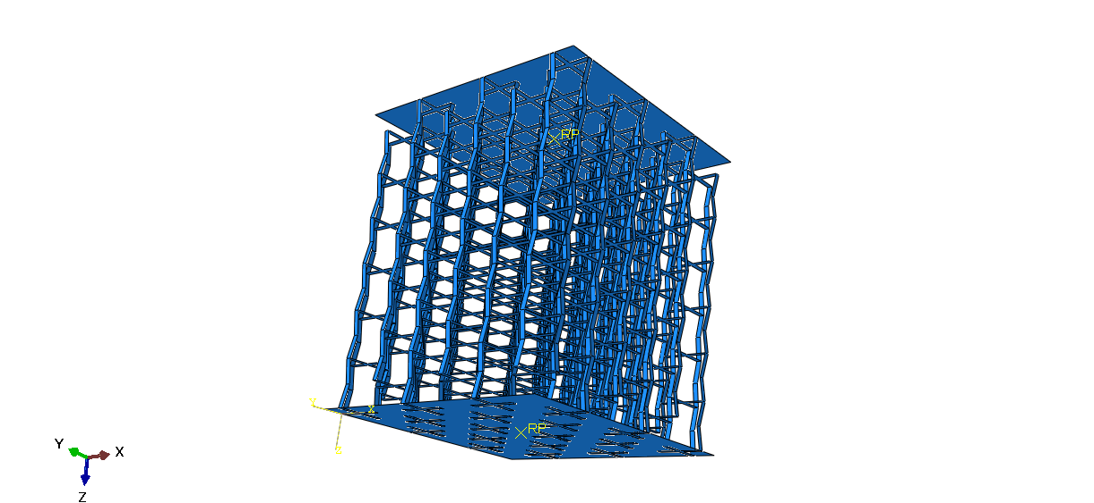
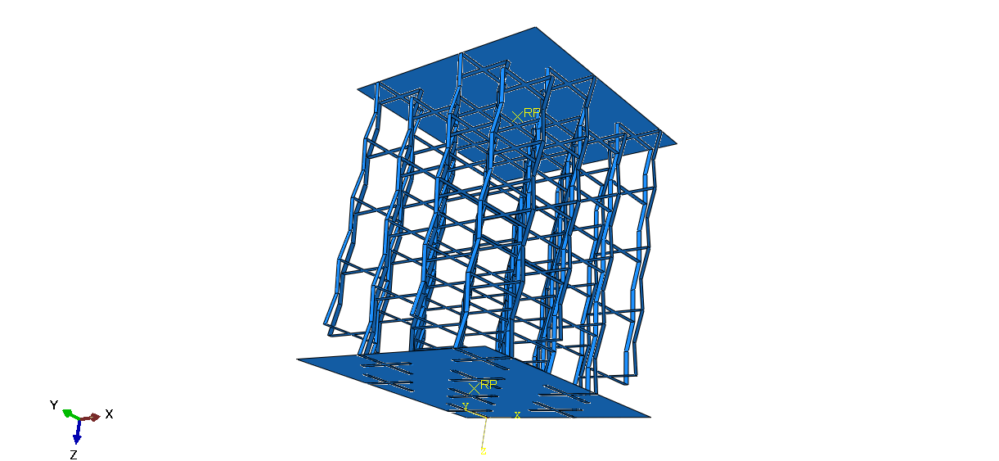
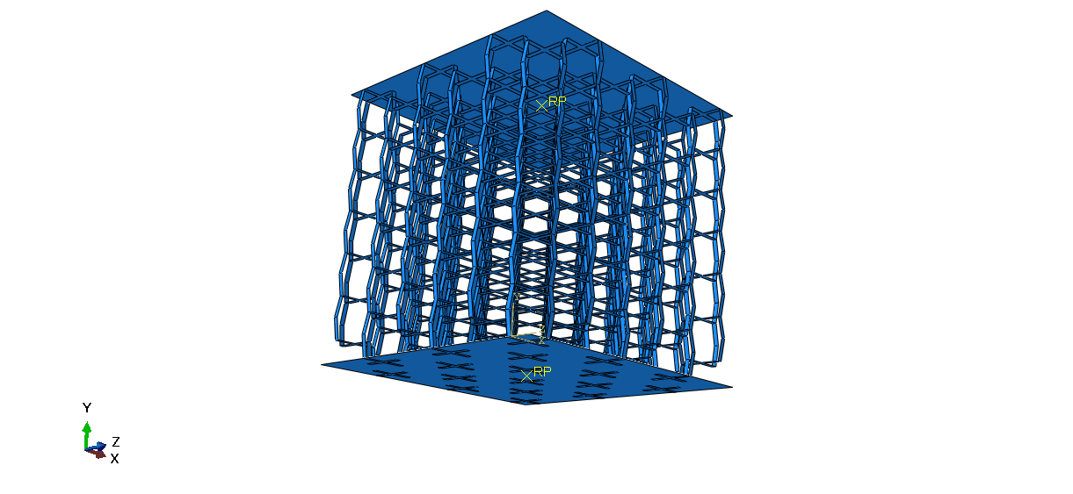
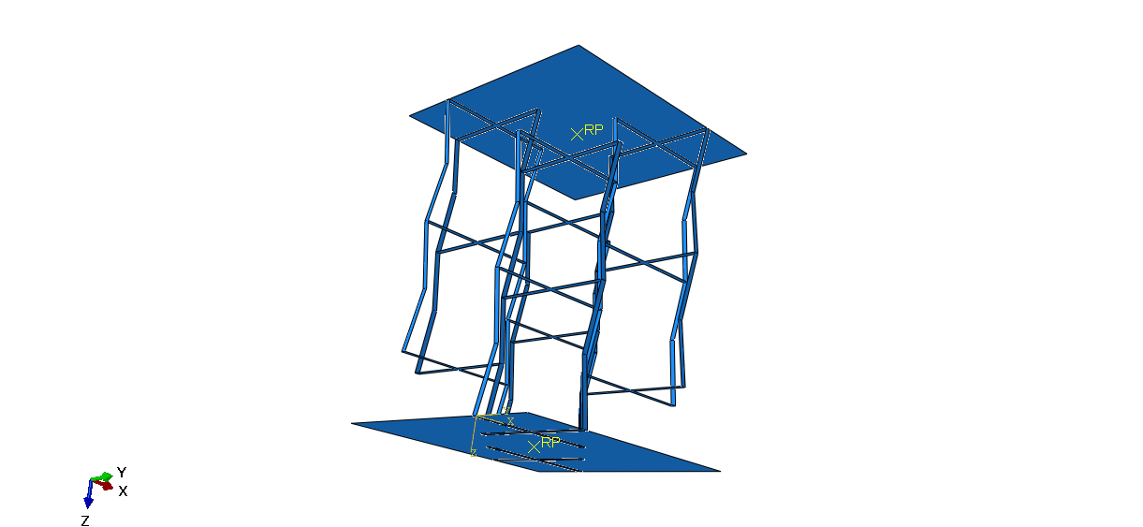
Results And Discussion continued
6x6 NPR assembly
NPR cell assembly
4x4 NPR assembly
Normal cell assembly
2x2 NPR assembly

Slide 23
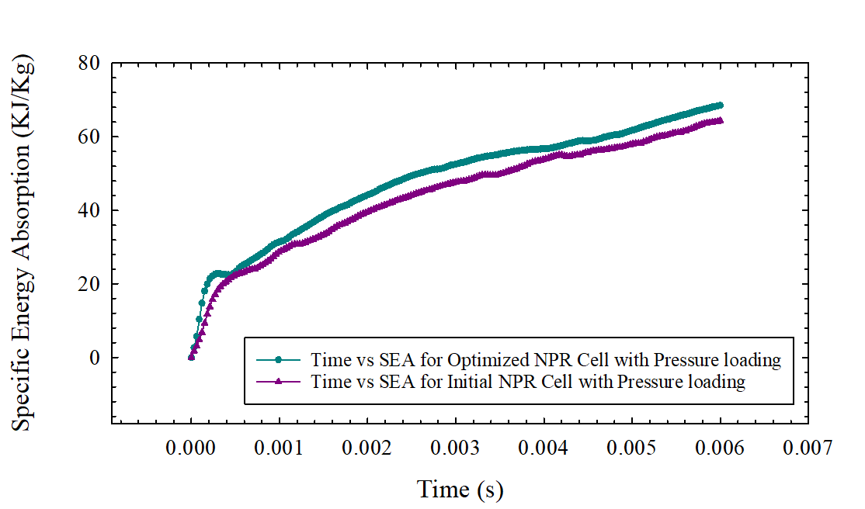



Results And Discussion continued

Slide 24


Results And Discussion continued

Slide 25
Results And Discussion continued
Design Combinations | Loading Conditions | Specific Energy Absorption | Improvements of optimized 6 cell assembly when compared to other combination
Initial NPR 6 cell design(30, 3, 2.28) | Pressure Loading (27.5 kg, 11.6m/s) | 61.135 (KJ/Kg) | 12.69%
Optimized NPR 6 cell design (10, 2 , 3.14) | Pressure Loading (27.5 kg, 11.6m/s) | 68.455 (KJ/Kg) | -
4 cell Optimized NPR assembly | Pressure Loading (27.5 kg, 11.6m/s) | 59.45 (KJ/Kg) | 13%
2 cell Optimized NPR assembly | Pressure Loading (27.5 kg, 11.6m/s) | 52.92 (KJ/Kg) | 23.23%

Slide 26
Conclusions
An unique structural constrained design optimization workflow is proposed incorporating Artificial Neural Network Prediction and Particle Swarm Algorithm.
A maximum improvement of SEA 12.69% was obtained when compared to the initial design.
A comparison of NPR and Normal cell Reaction force reveals that the NPR cell has 34.68% lower sustained pick RF when compared to its normal counter part.
The number of optimized design cells size were varied keeping the volume constant, the general trend revealed by the analysis is – the more number of cells the more amount of energy it will absorb but the pick reaction force will also increase simultaneously.
Future Scope – Extensive study of the NPR structure assembly based on vibrational and modal analysis.

Slide 27
References
[1] M. Guida, F. Marulo, and S. Abrate, “Advances in crash dynamics for aircraft safety,” Prog. Aerosp. Sci., vol. 98, no. December 2017, pp. 106–123, 2018.
[2] “Energy Absorption in composite stiffner.pdf.” .
[3] J. J. Carruthers, A. P. Kettle, and A. M. Robinson, “Energy absorption capability and crashworthiness of composite material structures: A review,” Appl. Mech. Rev., vol. 51, no. 10, pp. 635–649, 1998.
[4] P. Feraboli, “Development of a corrugated test specimen for composite materials energy absorption,” J. Compos. Mater., vol. 42, no. 3, pp. 229–256, 2008.
[5] T. Wang, J. An, H. He, X. Wen, and X. Xi, “A novel 3D impact energy absorption structure with negative Poisson’s ratio and its application in aircraft crashworthiness,” Compos. Struct., vol. 262, no. January, p. 113663, 2021.
[6] L. Cabras and M. Brun, “Auxetic two-dimensional lattices with Poisson’s ratio arbitrarily close to −1,” Proc. R. Soc. A Math. Phys. Eng. Sci., vol. 470, no. 2172, p. 20140538, Dec. 2014.
[7] I. S. Abbood, S. A. Odaa, K. F. Hasan, and M. A. Jasim, “Properties evaluation of fiber reinforced polymers and their constituent materials used in structures – A review,” Mater. Today Proc., vol. 43, pp. 1003–1008, Jan. 2021.
[8] J. Paz, J. Díaz, L. Romera, and M. Costas, “Size and shape optimization of aluminum tubes with GFRP honeycomb reinforcements for crashworthy aircraft structures,” Compos. Struct., vol. 133, pp. 499–507, 2015.

Slide 28
Thank You

